Slide 1
SDN with Raspberry Pi Progress
Name:
Mohamad Khairul Zamidi bin Zakaria (202180)
Muhammad Muzammel bin Imamuzel (202179)

Slide 2
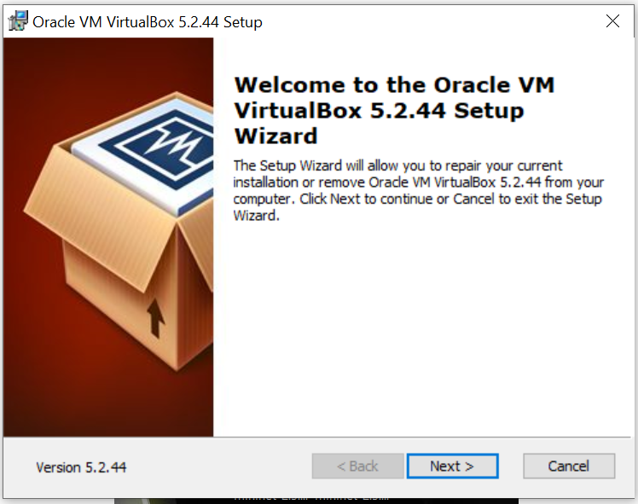
Installation of VirtualBox
Visit the Virtual Box website: https://www.virtualbox.org/wiki/Downloads and download the latest version according to the version of your operating system Windows, Mac or Linux.
Run the VirtualBox-5.2.44-137108-Win.exe and the Oracle VM Virtual Box Installation window will appear. Press Next.

Slide 3
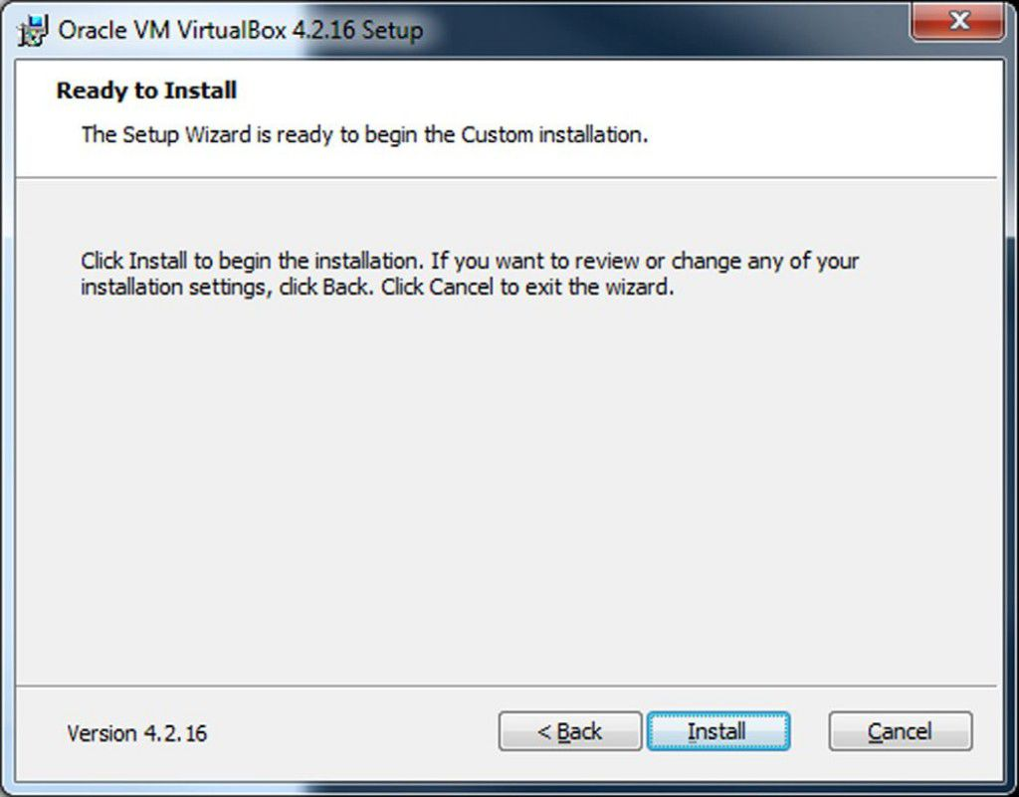
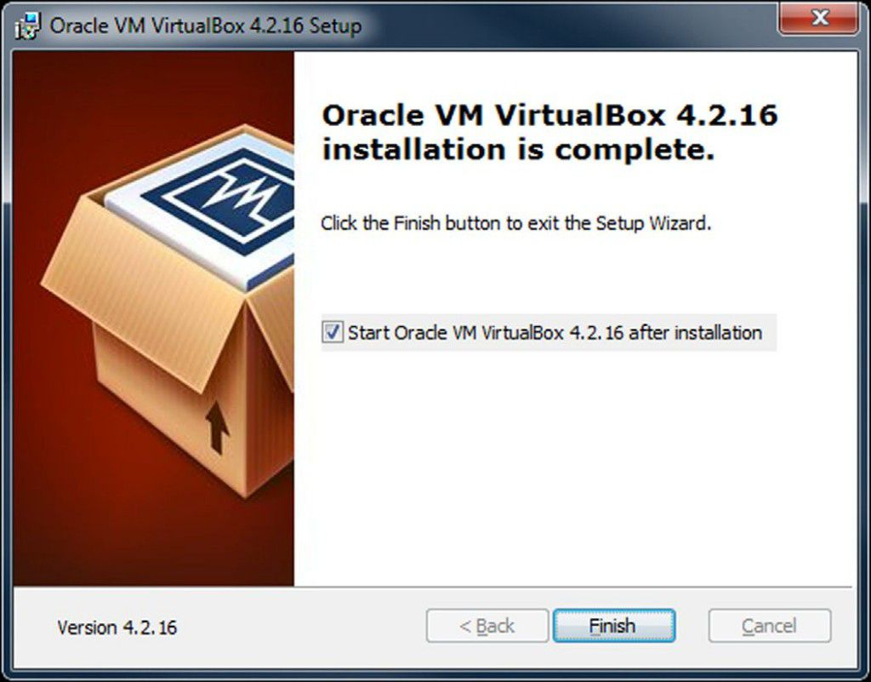
3. Follow step by step installation instructions. Click “Install” to start the installation and wait for the next step required until the installation is complete.

Slide 4
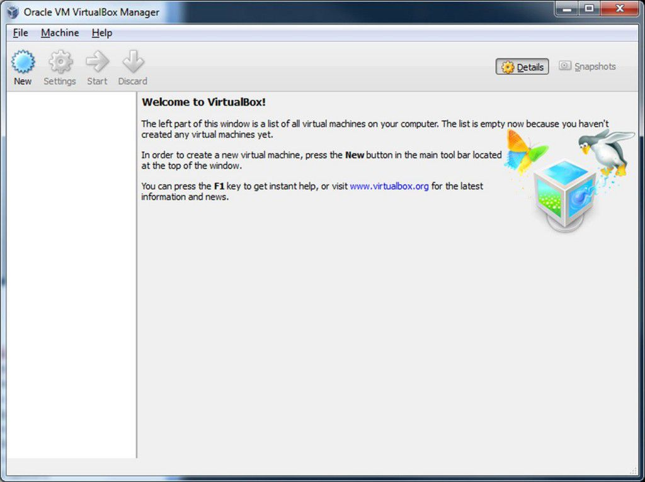
4. After finishing the installation process, the VirtualBox Window can be opened and can be used.

Slide 5

Installation of Mininet
Visit the Mininet website : https://github.com/mininet/mininet/releases/ and download the recommended installation.
After finish downloading the ovf zip file, extract it and open the folder after the extraction.

Slide 6
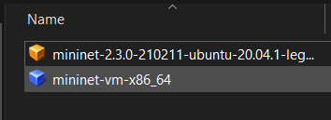
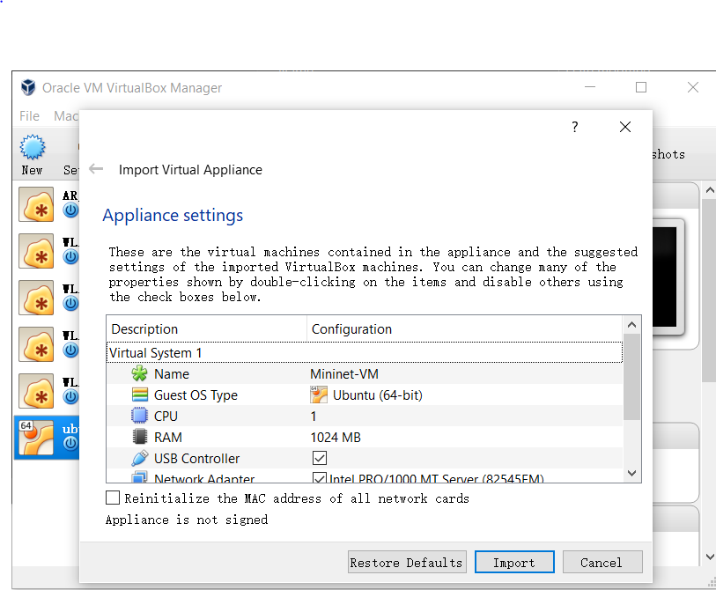
3. Double click on the mininet-2.3.0-210211-ubuntu-20.04.1-legacy-server-amd64
4. Import the virtual appliances into the virtual box

Slide 7
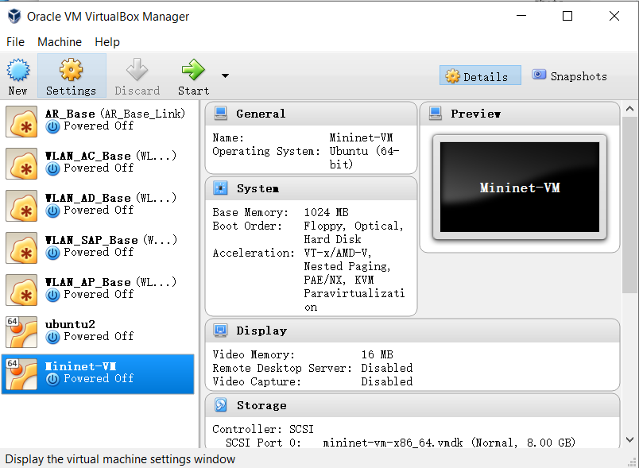
5. Finally, choose the Mininet-VM in the VirtualBox and run it.

Slide 8
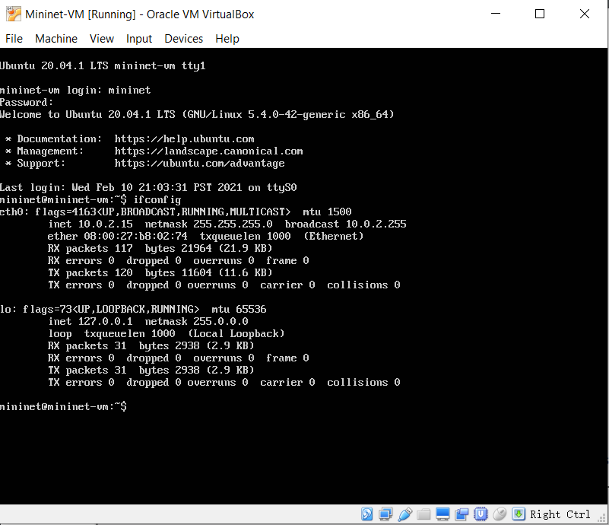
6. It should ask the user to put the username and password to login. The default username is mininet and password is mininet.

Slide 9
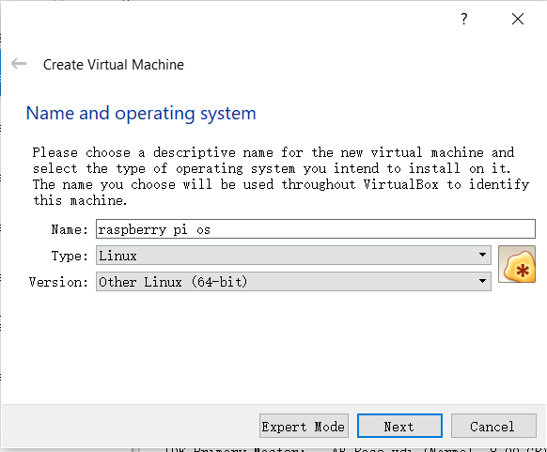
Installation of Raspberry Pi
Download the raspberry os iso file from https://www.raspberrypi.com/software/raspberry-pi-desktop/ here .
Open the VirtualBox and create new virtual machine

Slide 10
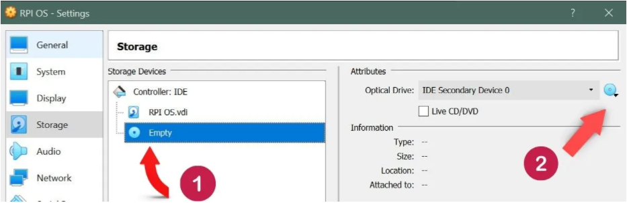
3. After creating the new virtual machine, follow the step below to choose the iso file downloaded before. Clicks the empty disks (1), and go to number (2) and selects the raspberry pi iso file that we downloaded earlier.

Slide 11
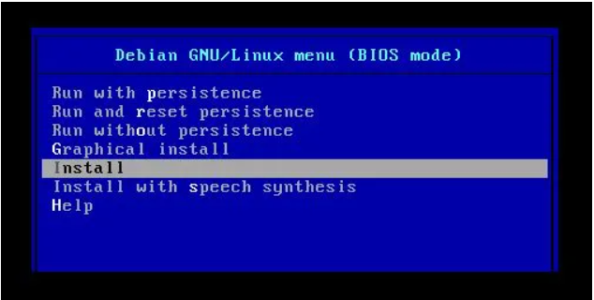
4. Start the raspberry pi os and install the the os in the bios
5. Restart the virtual machine and done.

Slide 12
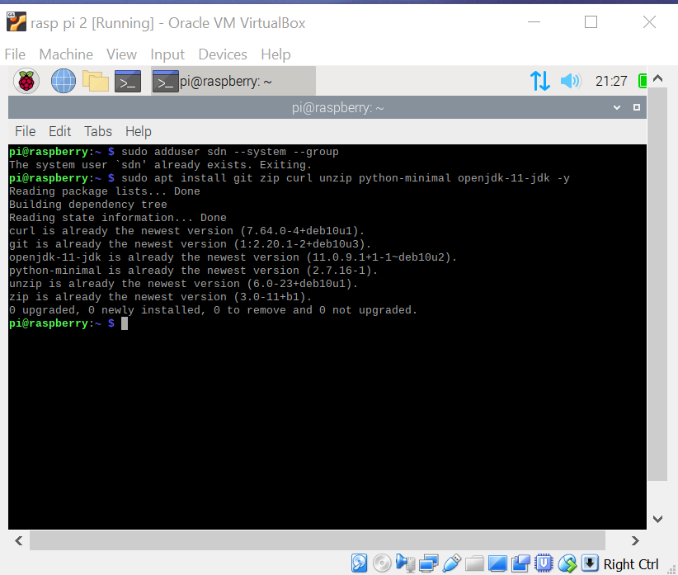
Installation of ONOS
Open Network Operating System (ONOS) is the controller that will be used as a control plane to control our SDN network. The ONOS controller will be installed in the Raspberry Pi virtual machine. First, we need to add a user for ONOS installation using command sudo adduser sdn –system –group
Install Java JDK 11. In our case, our java jdk is already up to date.

Slide 13
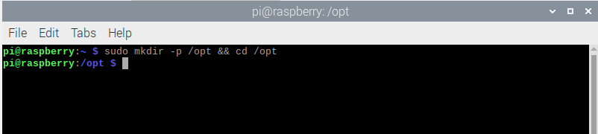
3. Create a directory “sudo mkdir -p /opt” as we will download and save the ONOS file in this directory.

Slide 14
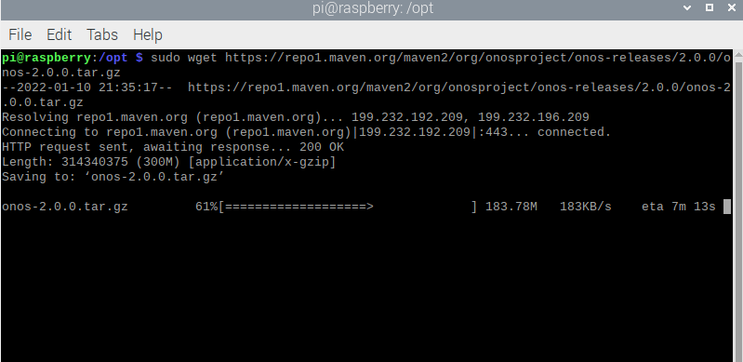
4. Next, we will download the onos version 2.0.0 through this link, https://repo1.maven.org/maven2/org/onosproject/onos-releases/2.0.0/onos-2.0.0.tar.gz . The file size is around 300MB, and it will take several minutes to download it.

Slide 15
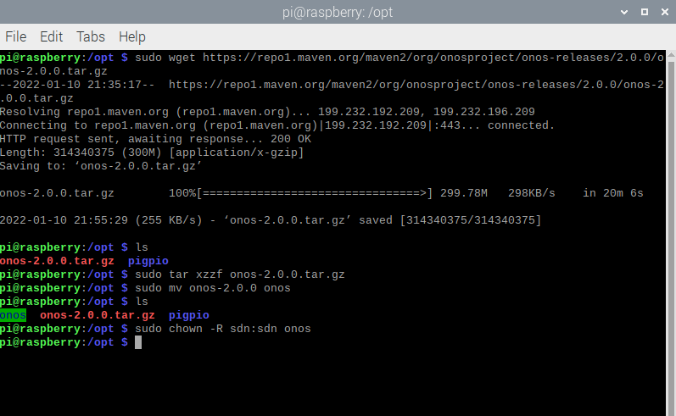
5. After finishing the download, we need to unzip the file, change the filename to onos, and create the ownership to the user that we created in the first step.

Slide 16
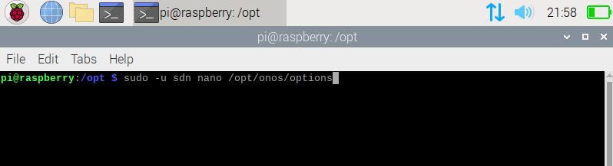
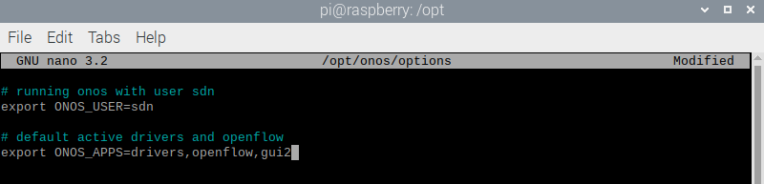
6. Next, we will set some settings for the startup of the ONOS. Go to directory /opt/onos/options and add the scripts below, to run onos with user sdn, and set the default active drivers and openflow.

Slide 17
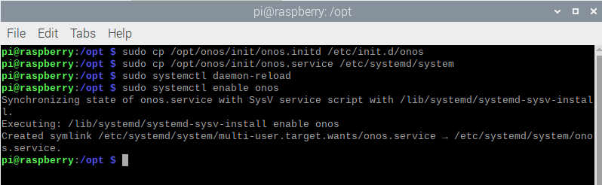
7. Install service file as below. Reload and enable onos, with this we already finish the installation of onos.

Slide 18
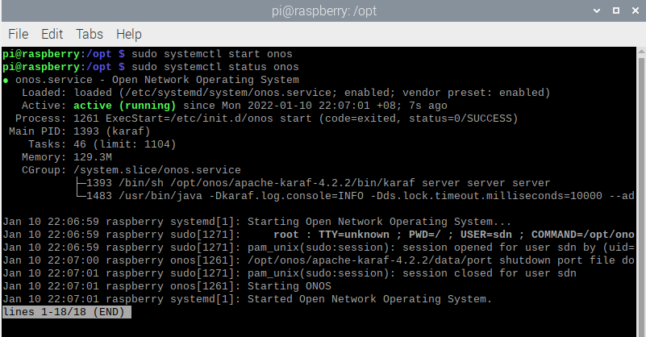
8. Start the ONOS controller using sudo systemctl start onos. Check the status of ONOS either running or not using sudo systemctl status onos.

Slide 19
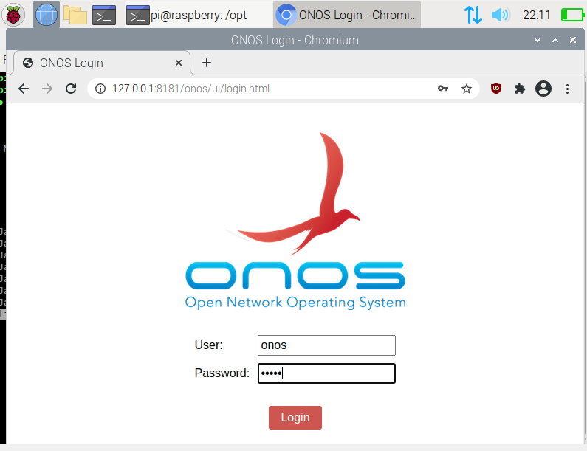
9. Run ONOS in the GUI version. The address is 127.0.0.1, using port 8181, and navigate to the login page, 127.0.0.1:8181/onos/ui/index.html. The username is onos and password used is rocks as defaults. In the application some of the features has been activated as we already set at the startup options.

Slide 20
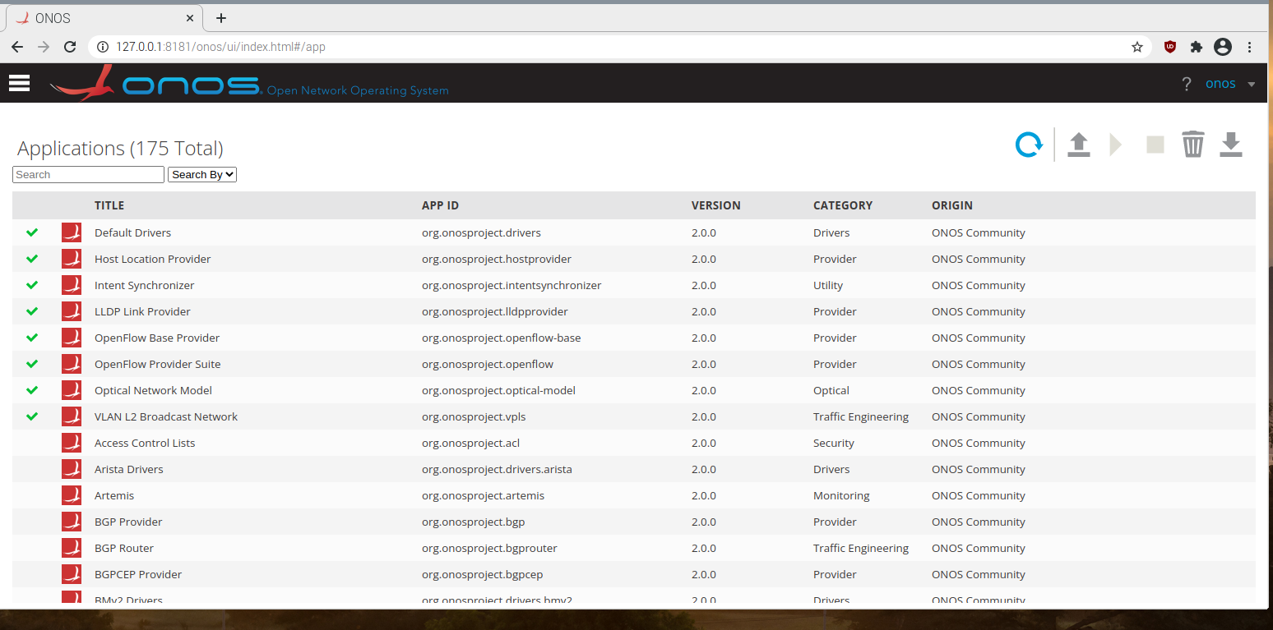

Slide 21
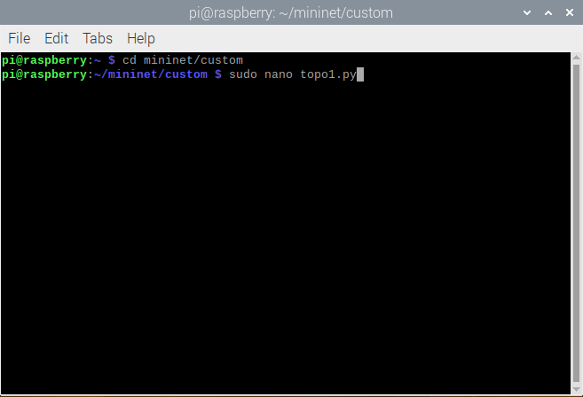
Creating topology in mininet
Go to directory mininet/custom
Create a python file as topo1.py with command “sudo nano topo1.py”

Slide 22
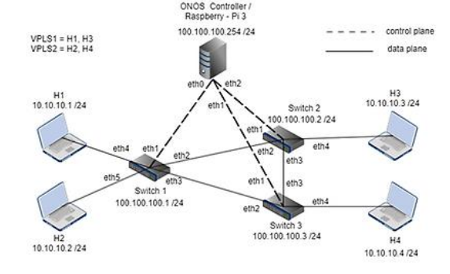
3. Below is the network topology that we will create for our SDN project. There will be 3 switches, 4 hosts, and one controller.

Slide 23
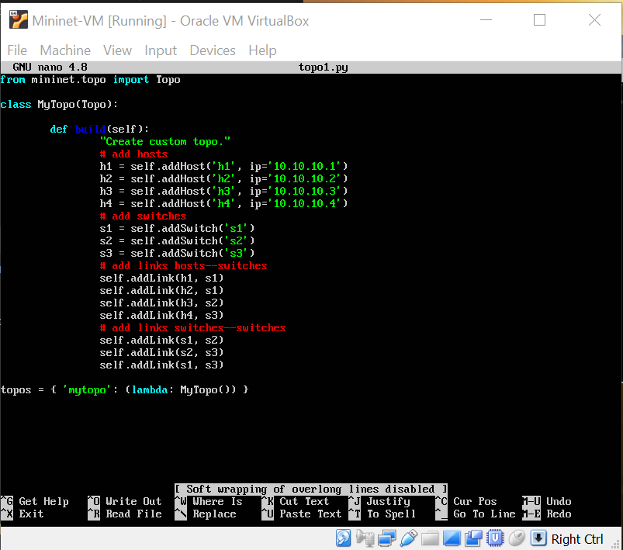
4. Write the python script for our topology. Here is our code.

Slide 24
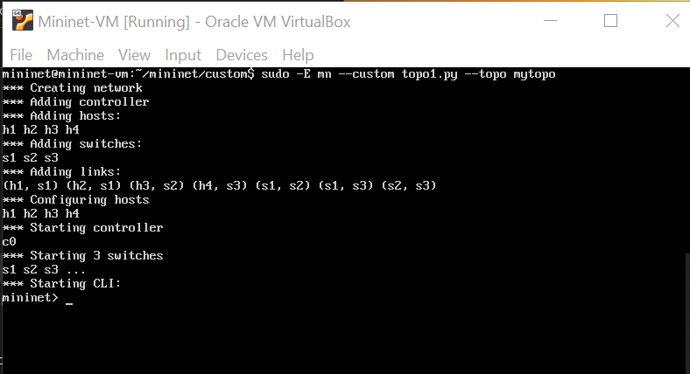
5. Try to run the topology without connecting to any controller yet. We can run the topology in the mininet.

Slide 25
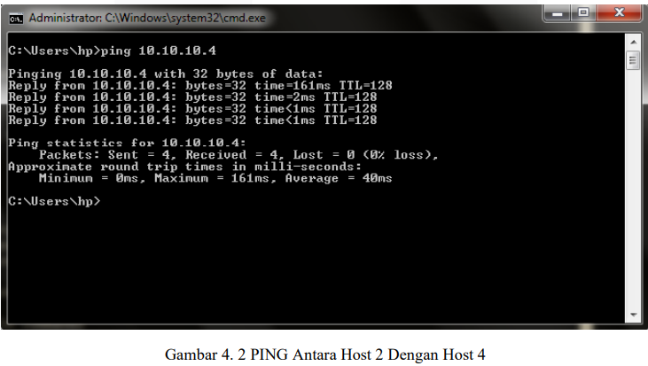
Next Progress
Run the topology and connect to the ONOS controller in Raspberry Pi VM.
Enable VPLS options in ONOS controller.
Ping each other hosts and our expected results like the research paper we used.

Slide 26
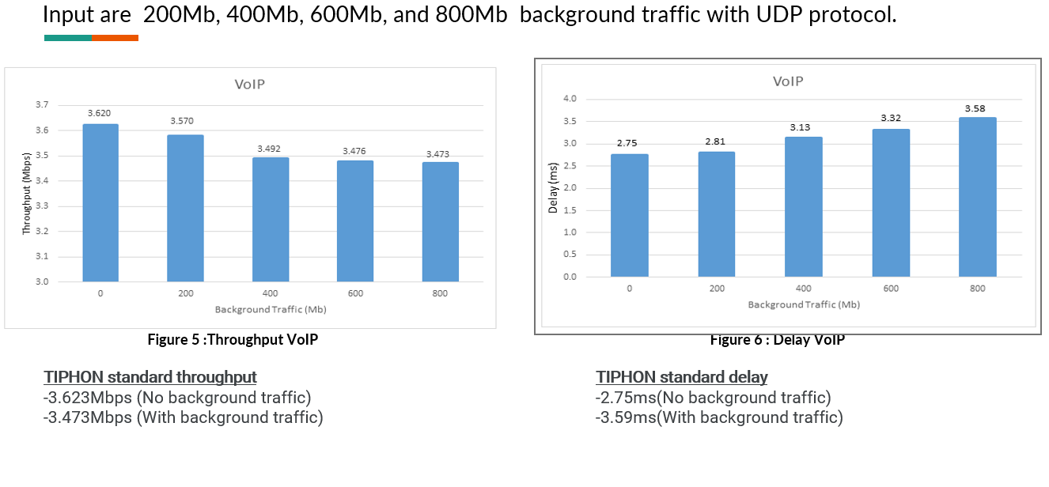
4. Measure the throughput VoIP, delay VoIP, Jitter VoIP performance test and expected this result:

Slide 27
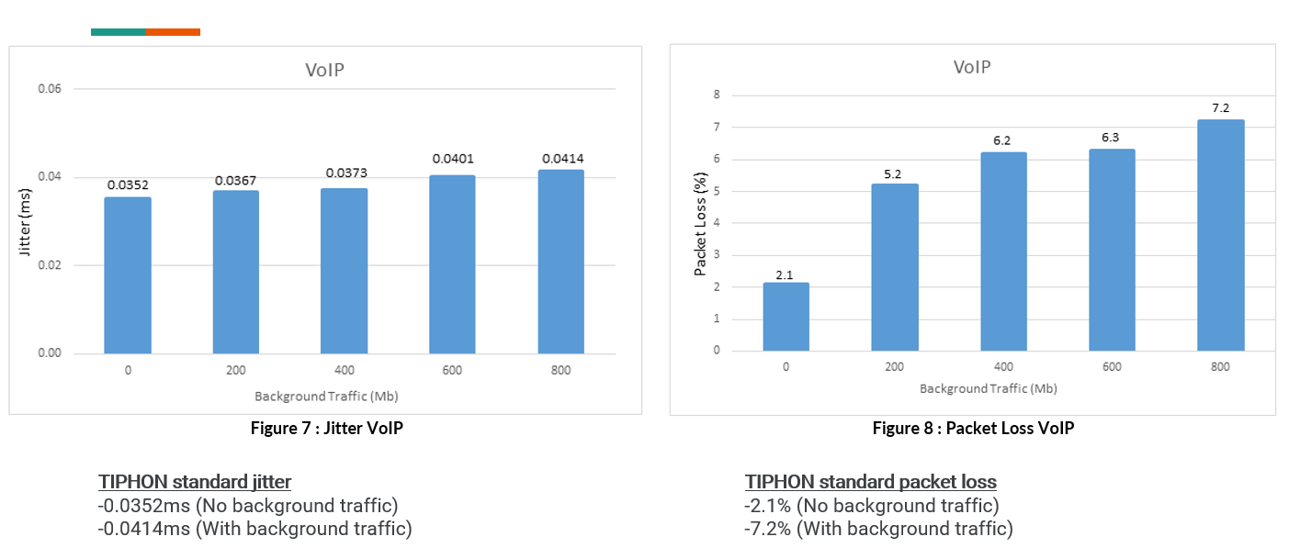

Slide 28
SDN with Raspberry Pi
By:
Mohamad Khairul Zamidi bin Zakaria (202180)
Muhammad Muzammel bin Imamuzel (202179)

Slide 29
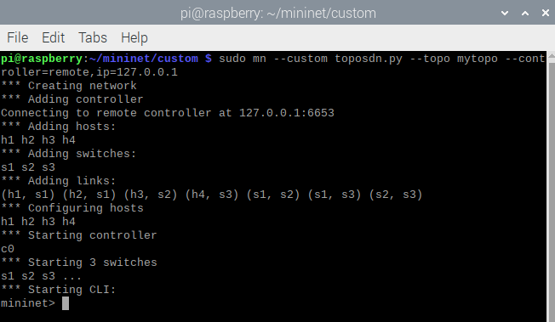
Connect Mininet to the ONOS controller
1. Run the topology and connect it to the ONOS controller.

Slide 30
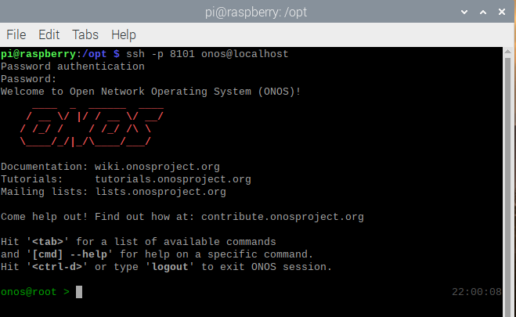
2. Open ONOS in command line (CLI).

Slide 31
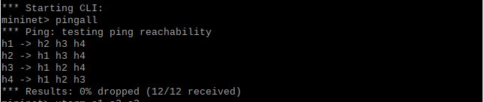
3. Trying to check the connectivity of all the hosts by using command ‘pingall’ in mininet. All the hosts are connected because 12/12 packets are received.

Slide 32
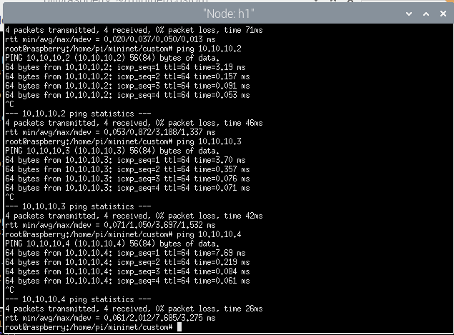
4. Open xterm for h1 and try to ping h2 (10.10.10.2) , h3 (10.10.10.3), and h4 (10.10.10.4). All ping is successful.

Slide 33
Measure the bitrate, jitter, and packet loss
For the performance measurement, we will use iperf3. To install iperf3, the command is “sudo apt install iperf3”, and it is already ready to use.
The Iperf3 server will be up at host1 and ready to listen at port 5201 by default.
First, at host 4, an iperf3 client with UDP protocol connected to the iperf3 server (10.10.10.1) with the bandwidth 200 Megabits/sec will send the packet in 10 seconds interval time.

Slide 34
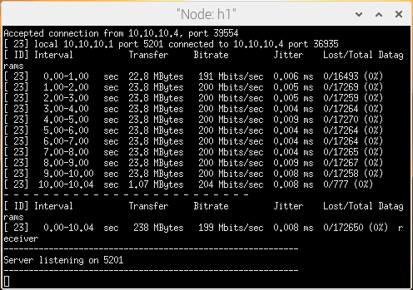
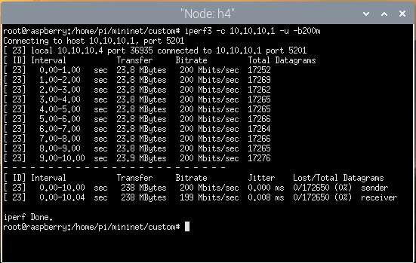
4. From step 3, we get the result. The data transferred to the server is 238 MBytes with 199 Mbits/sec, jitter is 0.008 ms, and no packet loss.

Slide 35
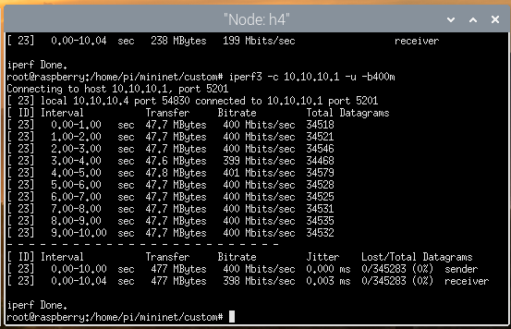
5. Next, we run the client with the same UDP protocol but with different bandwidths; 400Mb/s, 600Mb/s, and 800Mb/s.
UDP protocol with bandwidth 400Mb/s

Slide 36
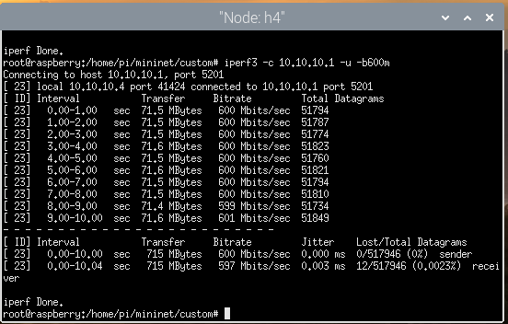
UDP protocol with bandwidth 600Mb/s

Slide 37
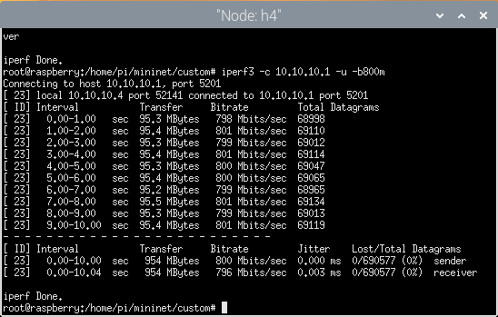
UDP protocol with bandwidth 800Mb/s

Slide 38
Results of experiments
UDP protocol, interval time = 10 seconds
Bandwidths, Mb/s | Transfer, MBytes | Bitrate, Mbits/s | Jitter, ms | Packet Loss, %
200 | 238 | 199 | 0.008 | 0
400 | 477 | 398 | 0.003 | 0
600 | 715 | 597 | 0.003 | 0
800 | 954 | 796 | 0.003 | 0

Slide 39
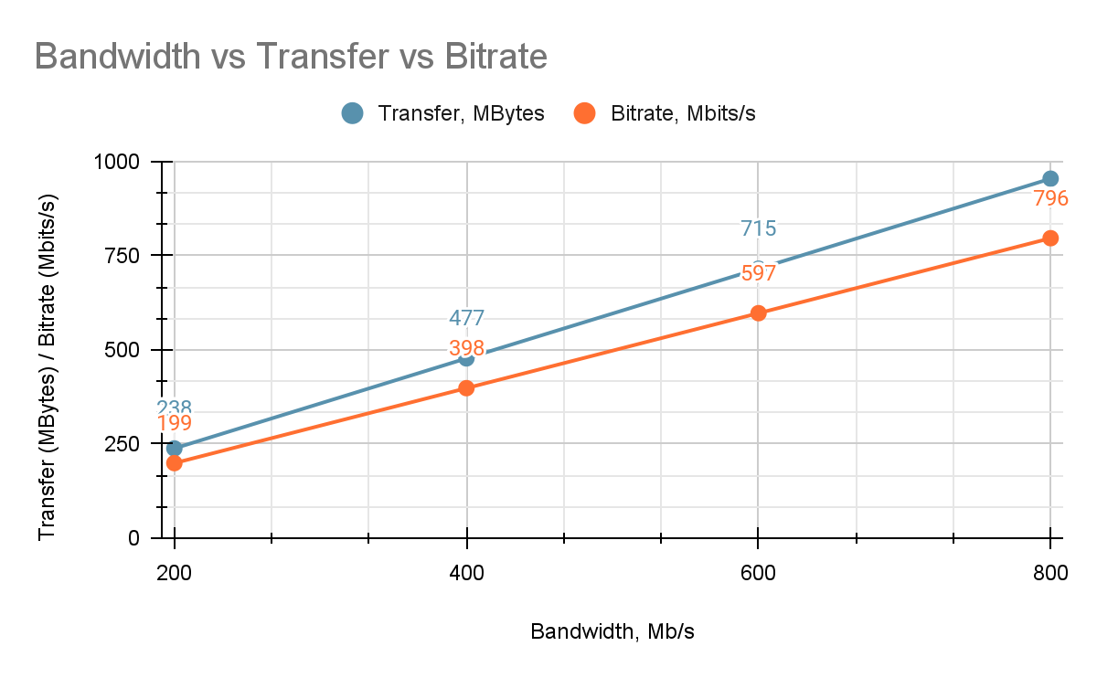

Slide 40
Conclusion
We are able to recreate the SDN network at Raspberry Pi VM.
We are able to use ONOS controller and the connection of the nodes in mininet is successful.
The performance measurements of the SDN network on Raspberry Pi is good.

